Slide 1

Applied Machine Learning
Project Group - 9
Trust Guard ML : Enhancing Open Metaverse Finance
Group Members:
Praveen Seelam
Rachana Mahapatra
Prudhvi Marpina
Kalyan Teja
Venakata Adithya
Sucharita Kakileti

Slide 2
Overview
Introduction
Project Objective
Exploratory Data Analysis
KMeans Clustering
Logistic Regression
Decision Tree
Random Forest
Recommendation & Conclusion

Slide 3

Introduction
The Open Metaverse emerges as a bustling hub for blockchain-based financial transactions.
Its significance lies in its role as a driver of the digital economy, facilitating trade, investment, and virtual asset exchange.
Built upon blockchain technology, it ensures the security and transparency of transactions.
However, navigating this landscape presents challenges, given the decentralized and anonymous nature of blockchain, alongside the surge in transaction volume.
Our project aims to tackle these hurdles by employing advanced machine learning techniques to safeguard blockchain financial transactions within the Open Metaverse.

Slide 4
Project Objective
Objective
Develop a robust system for analyzing blockchain financial transactions within the Open Metaverse.
Utilize machine learning, advanced techniques, to address challenges in Open Metaverse finance.
Problem Statements:
Detecting Fraudulent Transactions: Identifying fraudulent activities is complex due to the decentralized and anonymous nature of blockchain transactions, risking financial integrity.
Analyzing User Behavior: Lack of clear user behavior patterns hinders customization of financial services and overall security within the Open Metaverse.

Slide 5
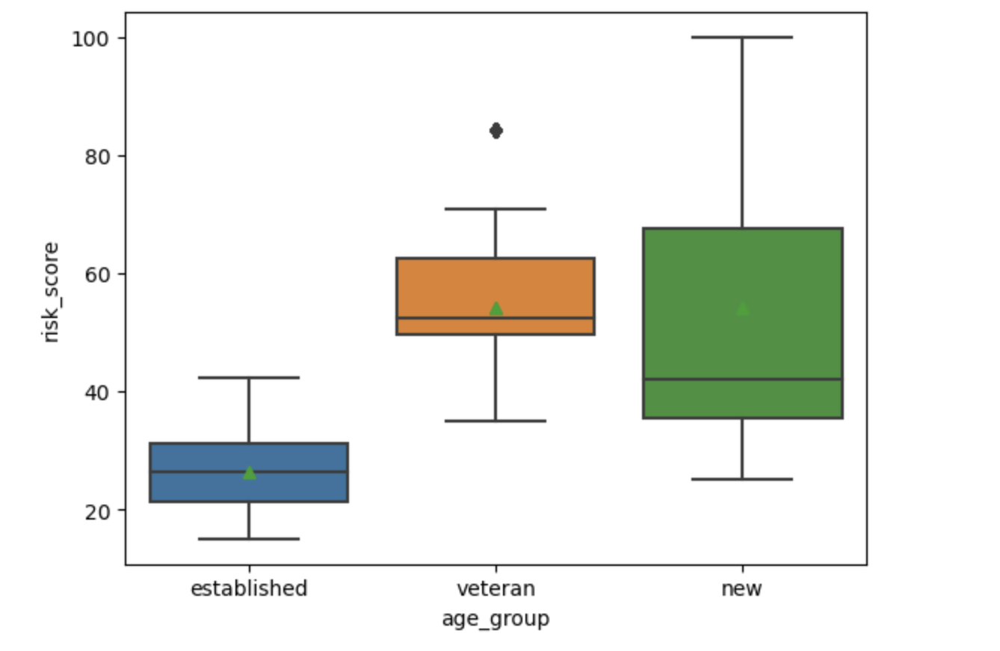
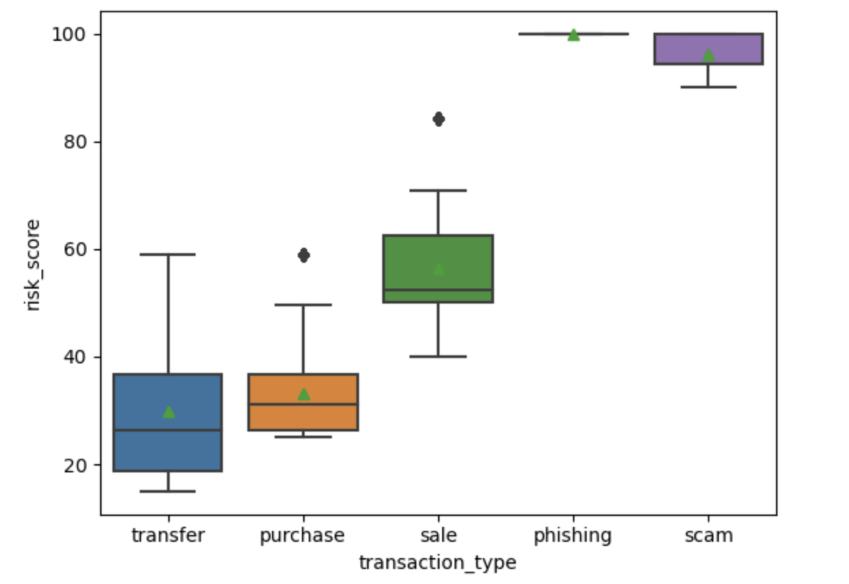
EDA
‘Risk-score’ vs ‘Age-group’
‘Transaction type’ – ‘Risk Score’

Slide 6
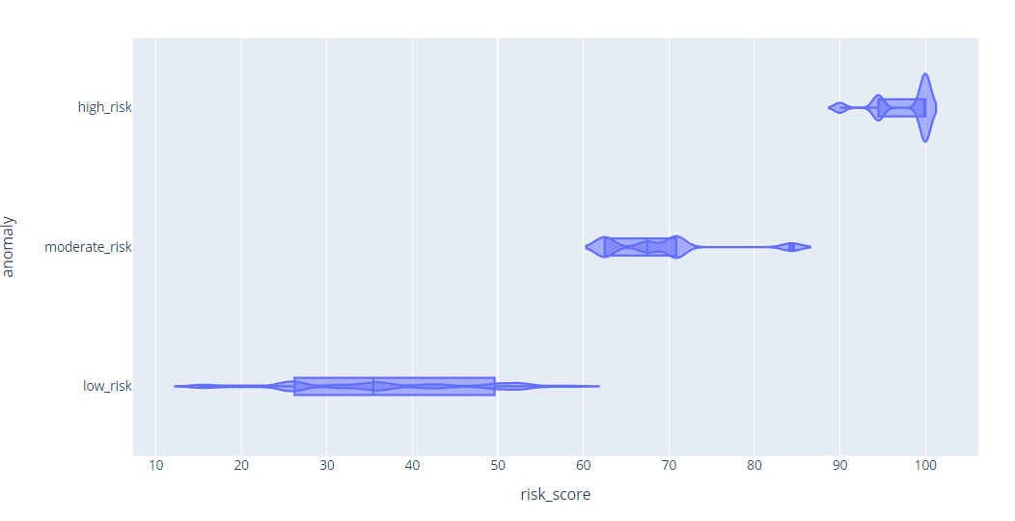
EDA
1. Risk Score vs Age Group:
Newer age group members exhibit higher and more variable risk scores compared to established and veteran groups.
2. Transaction Type vs Risk Score:
Scam transactions are associated with the highest risk scores, followed by transfers, with purchases and sales showing the lowest risk.
3. Risk Score Categorization: The 'high_risk' category displays a wide spread and high variability in scores, indicating diverse factors contribute to higher risk assessments.

Slide 7
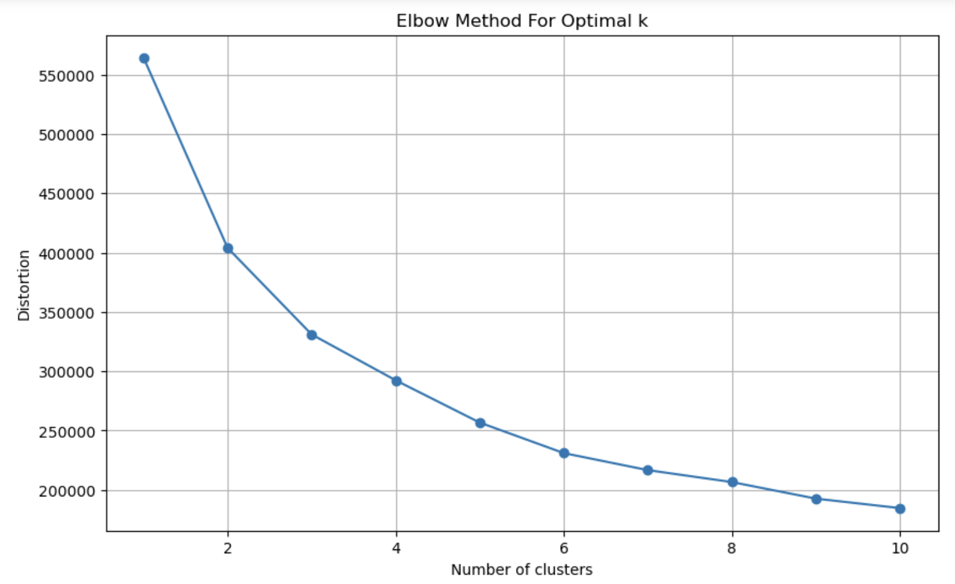
Kmeans Clustering – Visual Analysis
Distortion Decline: Reduction in distortion is notable up to 4 clusters, with diminishing returns afterward.
Optimal k Selection: Clear elbow at k=4, suggesting limited improvement with more clusters. Hence, k=4 is selected as optimal.

Slide 8
KMeans Clustering - Summary
Cluster 0:
Behavioral Traits: Infrequent engagement, low login frequencies, and short session durations.
Transaction Patterns: Mainly purchases with a 'random' pattern.
Risk Profile: Lowest risk levels, cautious transaction behavior.
Cluster 1:
Behavioral Traits: Highly active users, long session durations, and frequent logins.
Transaction Patterns: Primarily high-value sales.
Risk Profile: Moderate risk with 'moderate_risk' anomalies.
Cluster 2:
Behavioral Traits: Regular users with moderate engagement.
Transaction Patterns: Focused on consistent purchases.
Risk Profile: Very low risk, safest among clusters.
Cluster 3:
Behavioral Traits: Engagement similar to Cluster 0 but involved in risky behaviors.
Transaction Patterns: Engaged in 'phishing' and 'scam' activities.
Risk Profile: Contains high-risk anomalies, potentially fraudulent behavior.

Slide 9
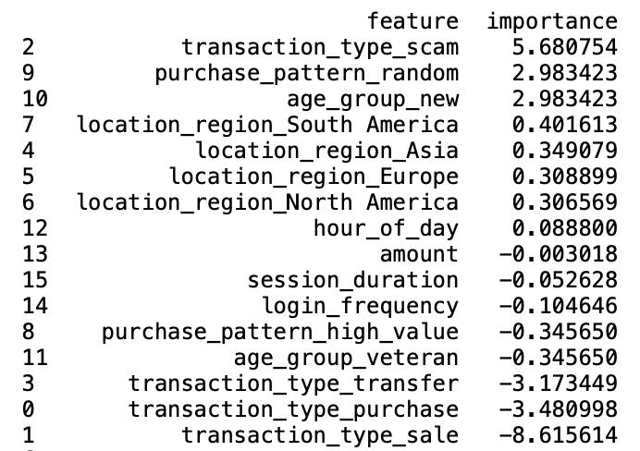
Logistic Regression – Feature Importance
Understanding Logistic Regression:
Supervised learning technique for classification tasks.
Constructs a linear decision boundary to classify transactions as fraudulent or legitimate based on features.
Advantages of Logistic Regression in Fraud Detection:
Transparent Decision-Making: Offers insights into the model's reasoning, aiding fraud identification understanding.
Scalability: Handles large datasets efficiently, crucial for real-time fraud detection.
Uncovering Complex Patterns: Detects intricate fraud patterns, enhancing detection accuracy.

Slide 10
Logistic Regression - Performance
High Risk (Class 0):
Precision: 100%
Recall: 100%
F1-Score: 100%
Support: 1,251 transactions
Low Risk (Class 1):
Precision: 97%
Recall: 97%
F1-Score: 97%
Support: 12,848 transactions
Moderate Risk (Class 2):
Precision: 79%
Recall: 80%
F1-Score: 79%
Support: 1,621 transactions
Overall Model Accuracy and Averages:
Accuracy: 96%
Macro Average: Precision: 92%, Recall: 92%, F1-Score: 92%
Weighted Average: 96%

Slide 11
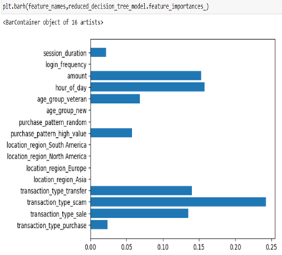
Decision Tree – Feature Importance
Decision Trees: Guardians Against Fraud:
Supervised learning technique for classification tasks.
Why Decision Trees Excel in Fraud Detection:
Transparent decision-making process, allowing us to understand how the model identifies fraud.
Builds a tree-like structure by splitting data based on features.
Each split targets the most informative feature for separating fraudulent and legitimate transactions.
Efficiently handle large datasets of transaction records.
Adept at uncovering complex patterns within the data, revealing hidden fraudulent activities.

Slide 12
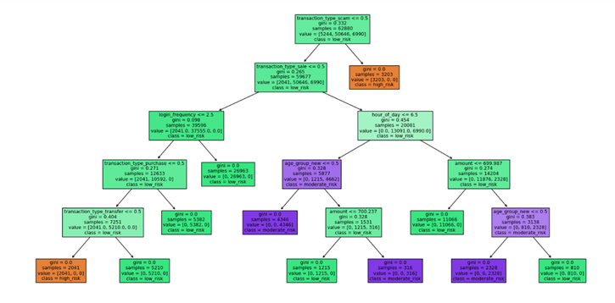
Decision Tree – Performance
Initial Decision Tree Construction:
Trained on labeled transaction dataset.
Achieved 100% test accuracy (potential overfitting).
Grid Search Hyperparameter Tuning:
Evaluates hyperparameter combinations systematically.
Focused on limiting tree depth to 5 to prevent overfitting.
Final Model Performance:
Maintained 100% test accuracy with reduced complexity.

Slide 13
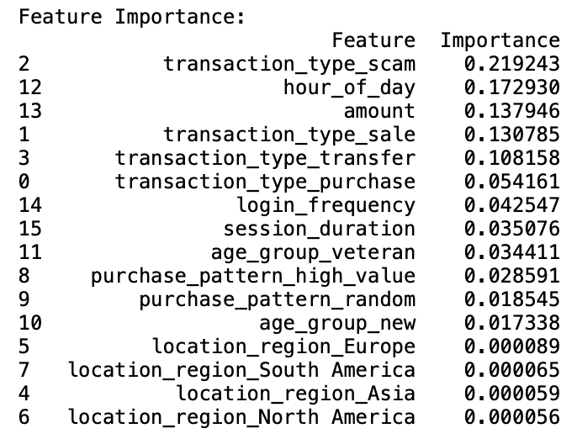
Random Forest – Feature Importance
Random Forest:
Supervised learning ensemble method for classification tasks.
Constructs multiple decision trees and aggregates their predictions to classify transactions as fraudulent or legitimate based on features.
Advantages of Random Forest in Fraud Detection:
Transparent: Offers insights into decision-making, aiding fraud identification understanding.
Scalable: Handles large datasets efficiently for real-time fraud detection.
Pattern Detection: Uncovers intricate fraud patterns, enhancing detection accuracy.

Slide 14
Random Forest - Performance
Precision:
Correctly predicted instances among all predicted instances.
Class 0 (high_risk): 100%
Class 1 (low_risk): 99%
Class 2 (moderate_risk): 100%
Recall:
Correctly predicted instances among all actual instances.
Class 0 (high_risk): 97%
Class 1 (low_risk): 100%
Class 2 (moderate_risk): 95%
F1-score:
Harmonic mean of precision and recall, balancing the two metrics.
Class 0 (high_risk): 98%
Class 1 (low_risk): 100%
Class 2 (moderate_risk): 98%

Slide 15


Recommendations & Conclusion
Conclusion
Strong Performance on Clear Risks: Both the Logistic Regression and Random Forest models excel in identifying high and low-risk transactions with high accuracy. The Decision Tree aids effective real-time monitoring. Improvement Needed for Moderate Risks: The Logistic Regression model needs better tuning for moderate-risk transactions, while the Random Forest shows better but still imperfect performance. Recommend Strategic Enhancements: Focus on enriching data for moderate risks, refining features, and leveraging advanced techniques, supplemented by Decision Tree monitoring for real-time insights. These points highlight the strengths in high clarity cases and areas for improvement in ambiguous cases.
Recommendations
Intensive Monitoring: Implement advanced anomaly detection in Cluster 3 to spot unusual patterns quickly.
Custom Security Protocols: Tailor security measures for Cluster 3, including multi-factor authentication and blockchain verification.
Broad Vigilance: Maintain dynamic monitoring across all clusters to catch shifting fraud tactics.
This strategic focus will enhance fraud prevention effectiveness in the Metaverse.

Slide 16

Questions ?

Slide 17
Thank You

